Slide 1
Improved Uniaxial TensiometeR

Slide 2
Key components
Ratchet Crank
Pulleys
Metal Rope
LCD Screen
3D Printed Clamps

Slide 3


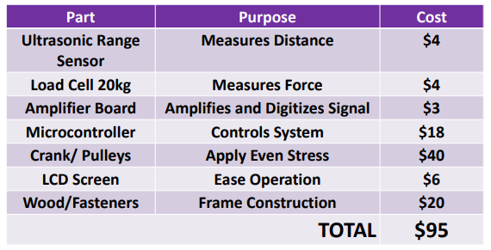
Advantages of the system
Cost effectiveness.
User friendly.
Easily Replaceable parts.
Easy Calibration process
Accurate and Reliable results.

Slide 4
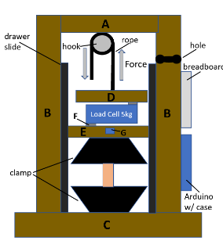
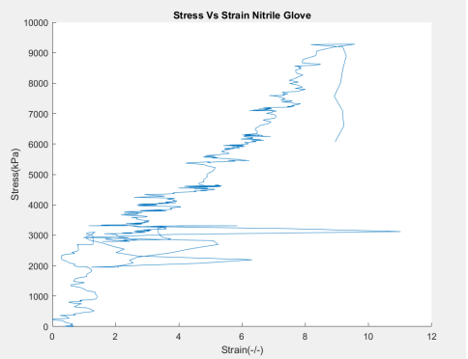
System evolution
Initial Design and Results:

Slide 5
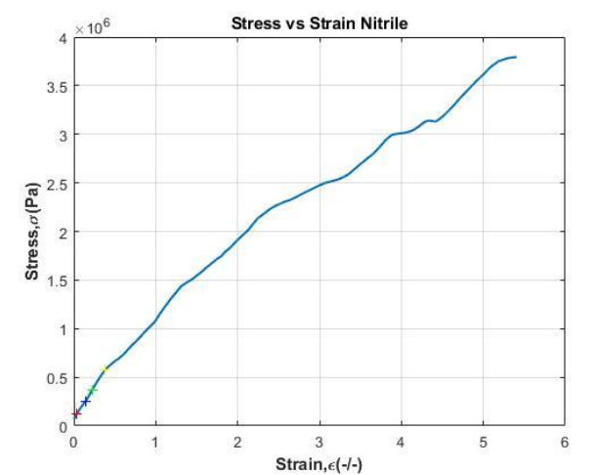
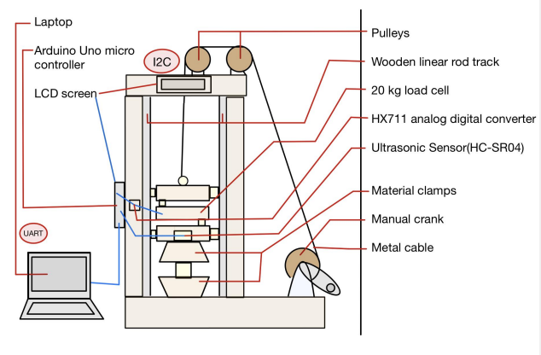
System evolution
Modified Design and Results:

Slide 6
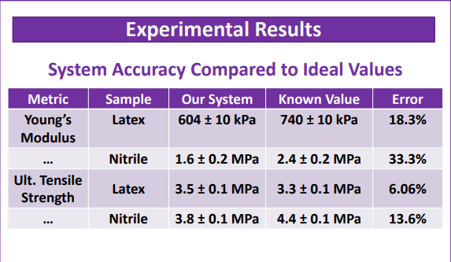
Evolution

Slide 7
Avenues for improvement
Data Analysis that does not depend on MATLAB
Additional 3D printed components
Data retrieval independent of computer connection
Smaller footprint
Better sensors
Taller linear track for more elastic materials

